Slide 1
DevelopHER 2016
Proudly sponsored by MYOB

Slide 2


Slide 3
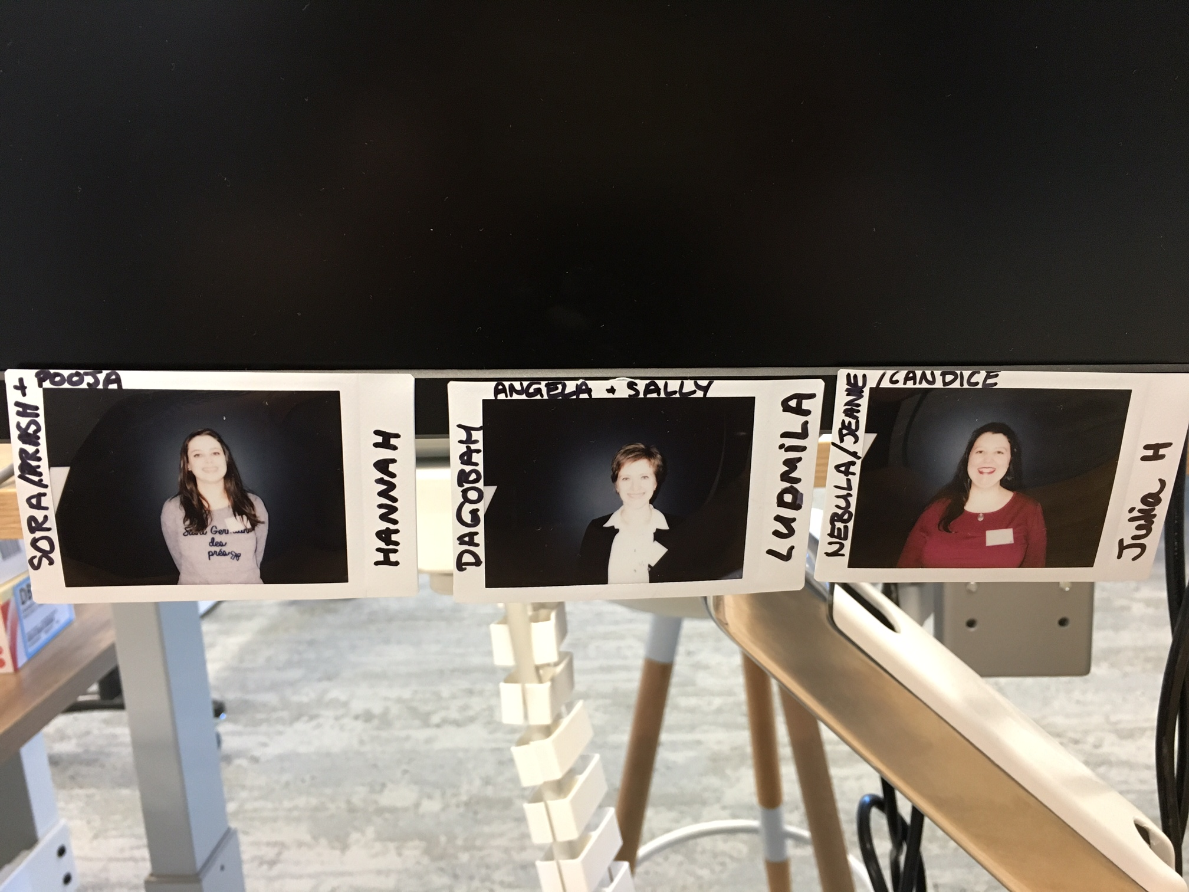
DevelopHERs – The final 3
Hannah Deutscher
Ludmila Stakhovych
Julia Harper
Photos taken on the interview day, showing us full of excitement and hope! We had no idea they would be a permanent fixture on Tanya’s desk! The first of many great poses.

Slide 4
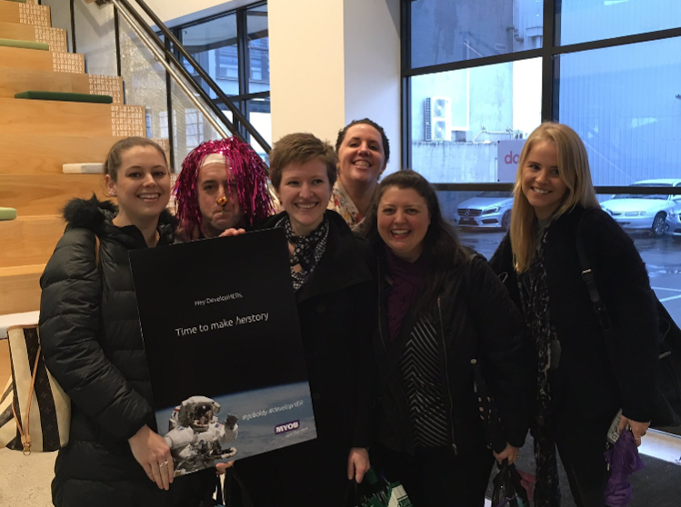
First day as DevelopHERs
Our first day at MYOB as DevelopHER interns, we did not know who our fellow developHERs were until we met at breakfast, and we agree that you couldn’t have picked better students ☺
We were all a little shy and a little nervous on our first day, but thanks to the openness and warmth of the team that didn’t last very long!
It is still amazing to say that we were the three chosen from so many applicants and feel lucky every day ☺

Slide 5
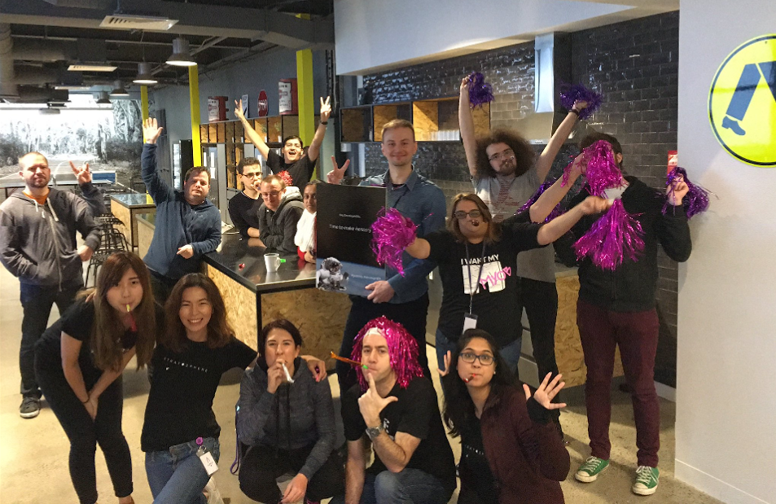
DevelopHERs welcoming celebration
An epicly enthusiastic welcome from the team we would come to know and love! Don’t worry Andrew, we can still see you behind Mandy’s third arm, and Dan is managing to keep both hands in his pockets whilst also giving a rock salute ☺

Slide 6
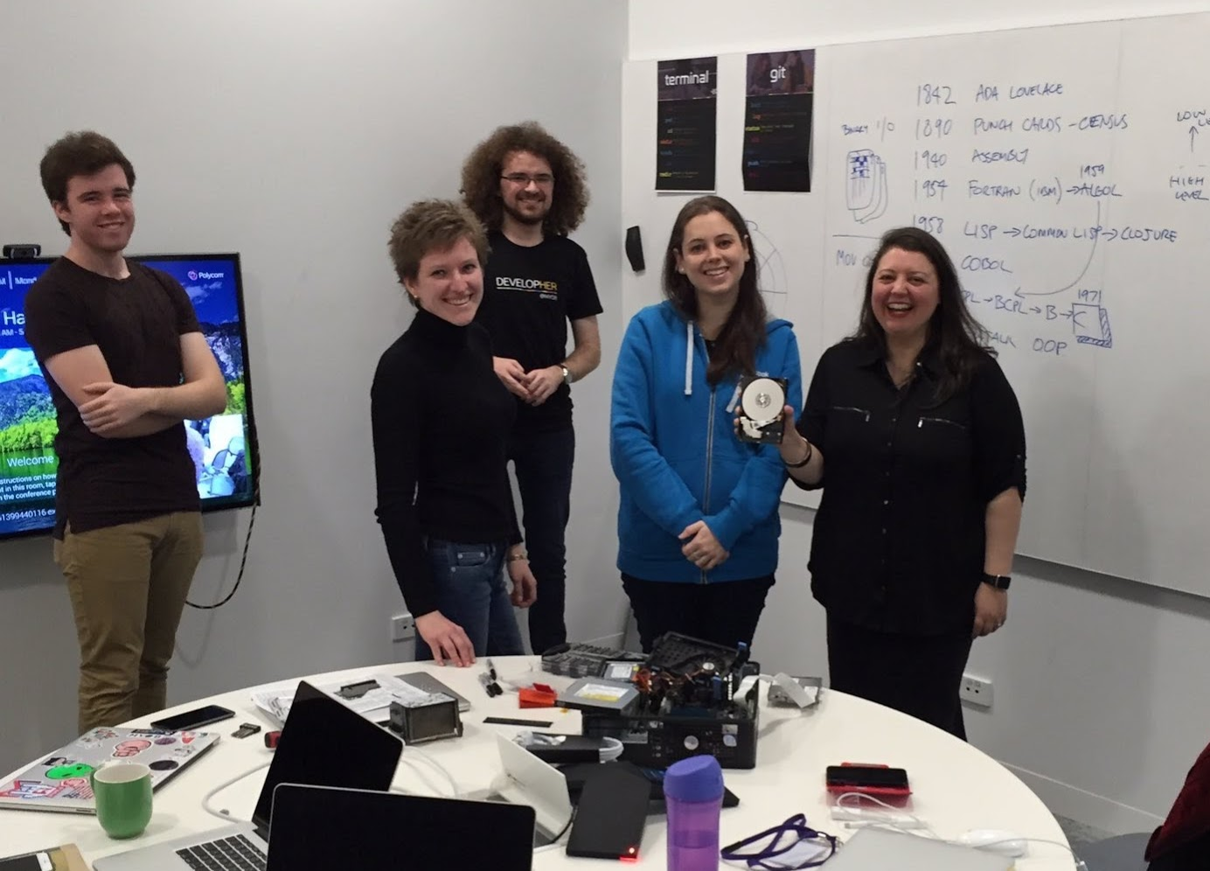
School of hard knocks…
Tech class day 1 - Our first day of school where we met our teachers and started to learn from the now infamous scrolls of wisdom.
An awesome history re-cap with Dan made us realize how wide and amazing the world of coding really is, and how it has progressed so quickly.
We then learnt how a computer physically works – and what better way to learn than to completely destroy one!
This one still had a hard disk drive so we are pretty sure it won’t be missed ☺

Slide 7
Our future – Learning the Agile Manifesto Terminal & Git Commands

Slide 8
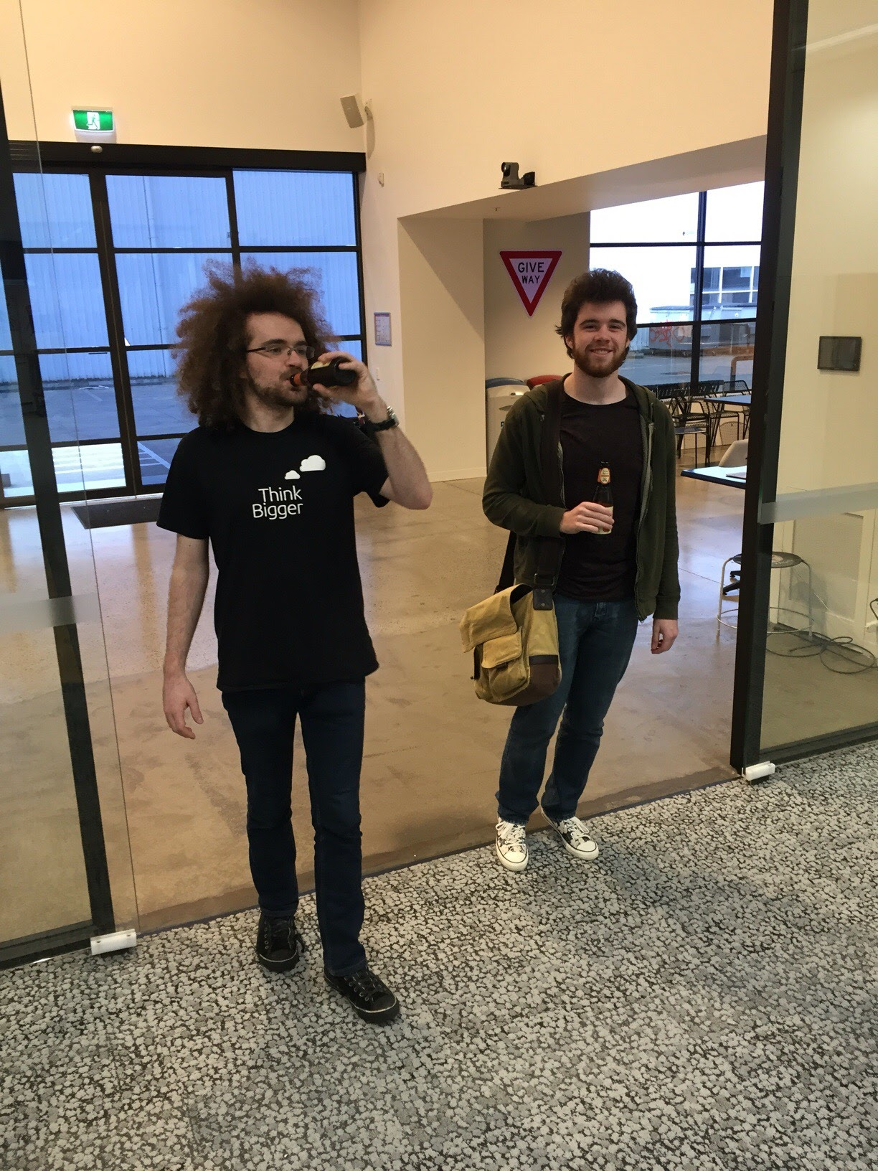
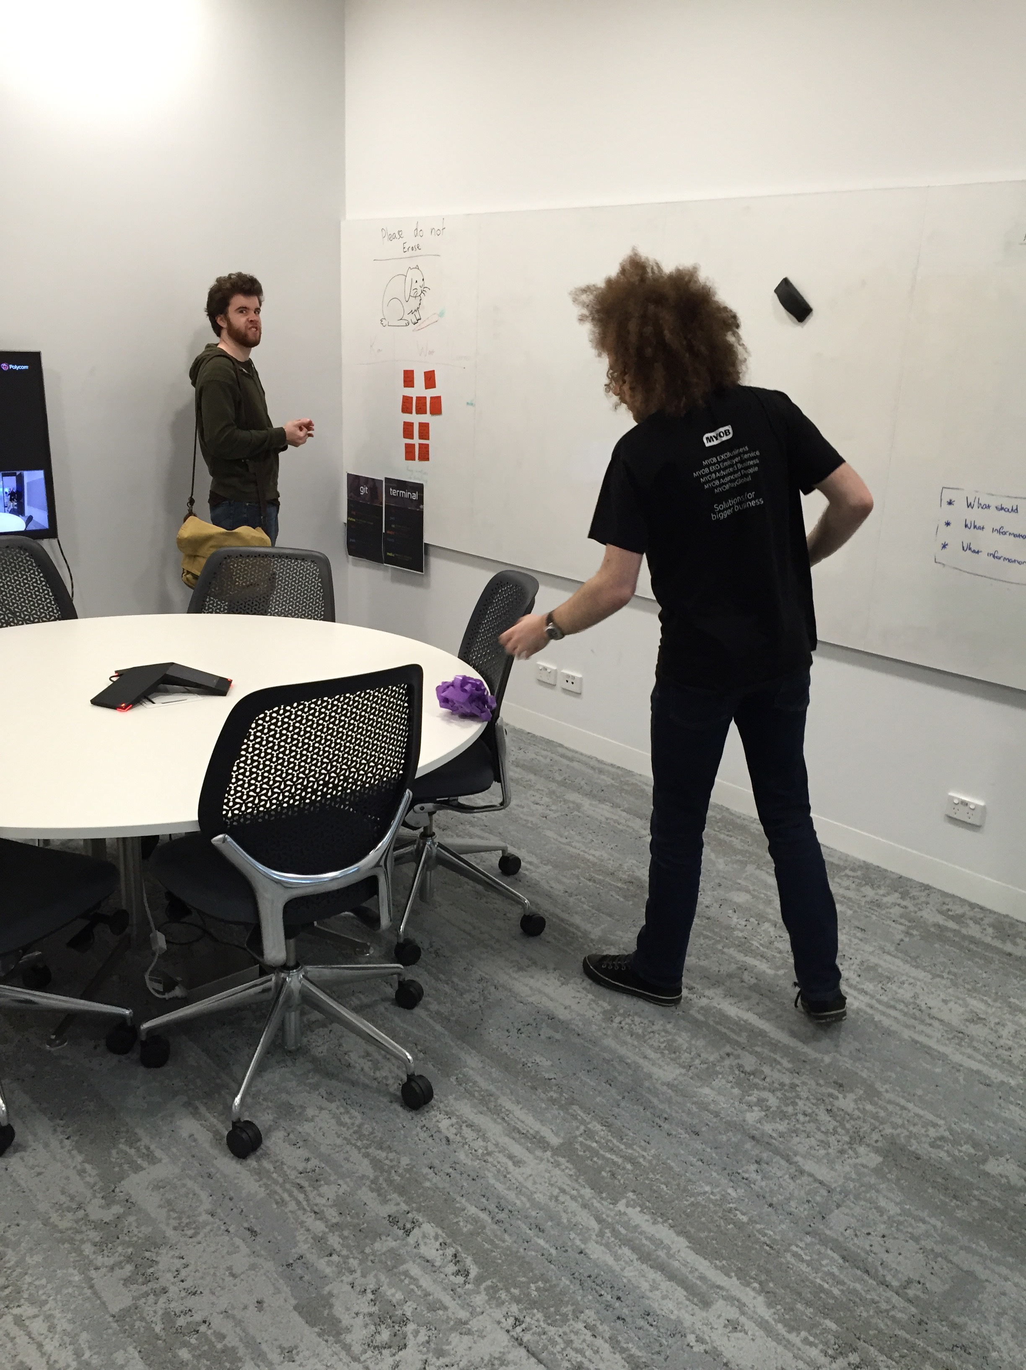
Teachers
We were very lucky to have many amazing people as a part of our learning journey including Oggie, Vivian and SRA.
The stars of the show were definitely Andrew and Jonathan, who were with us almost every lesson every day.
Their passion, enthusiasm and patience ensured we overcame every challenge, stayed positive and were always ready to come back for more!

Slide 9
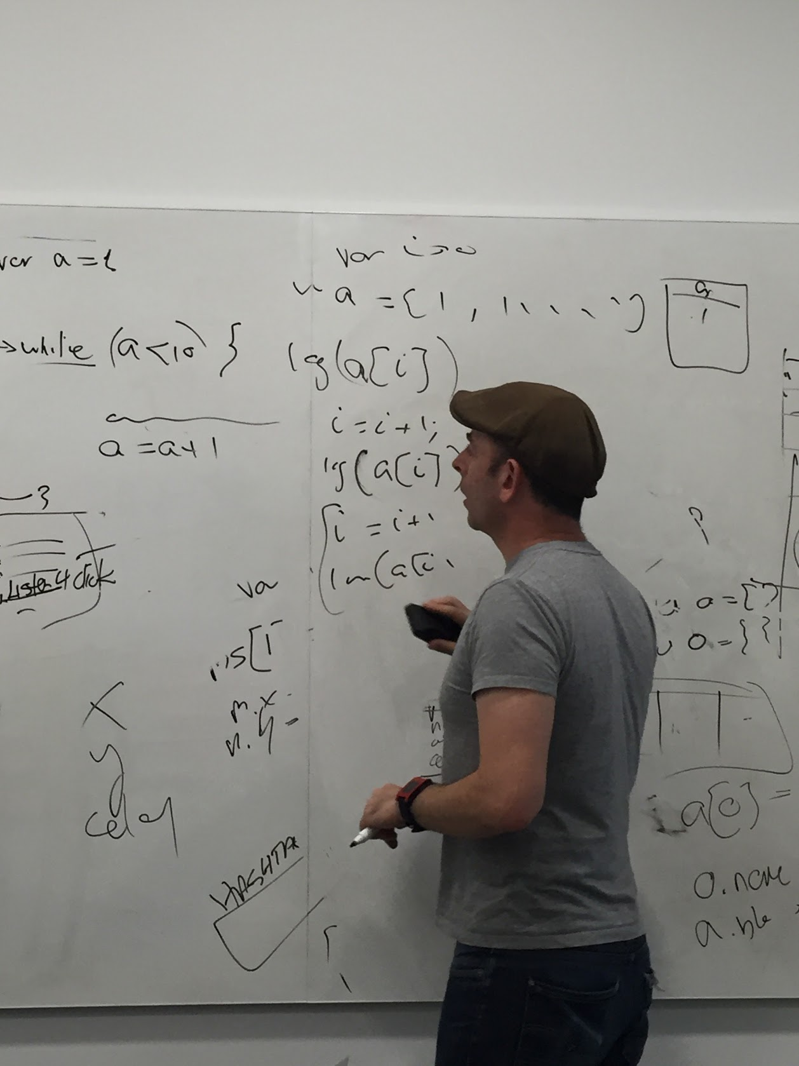
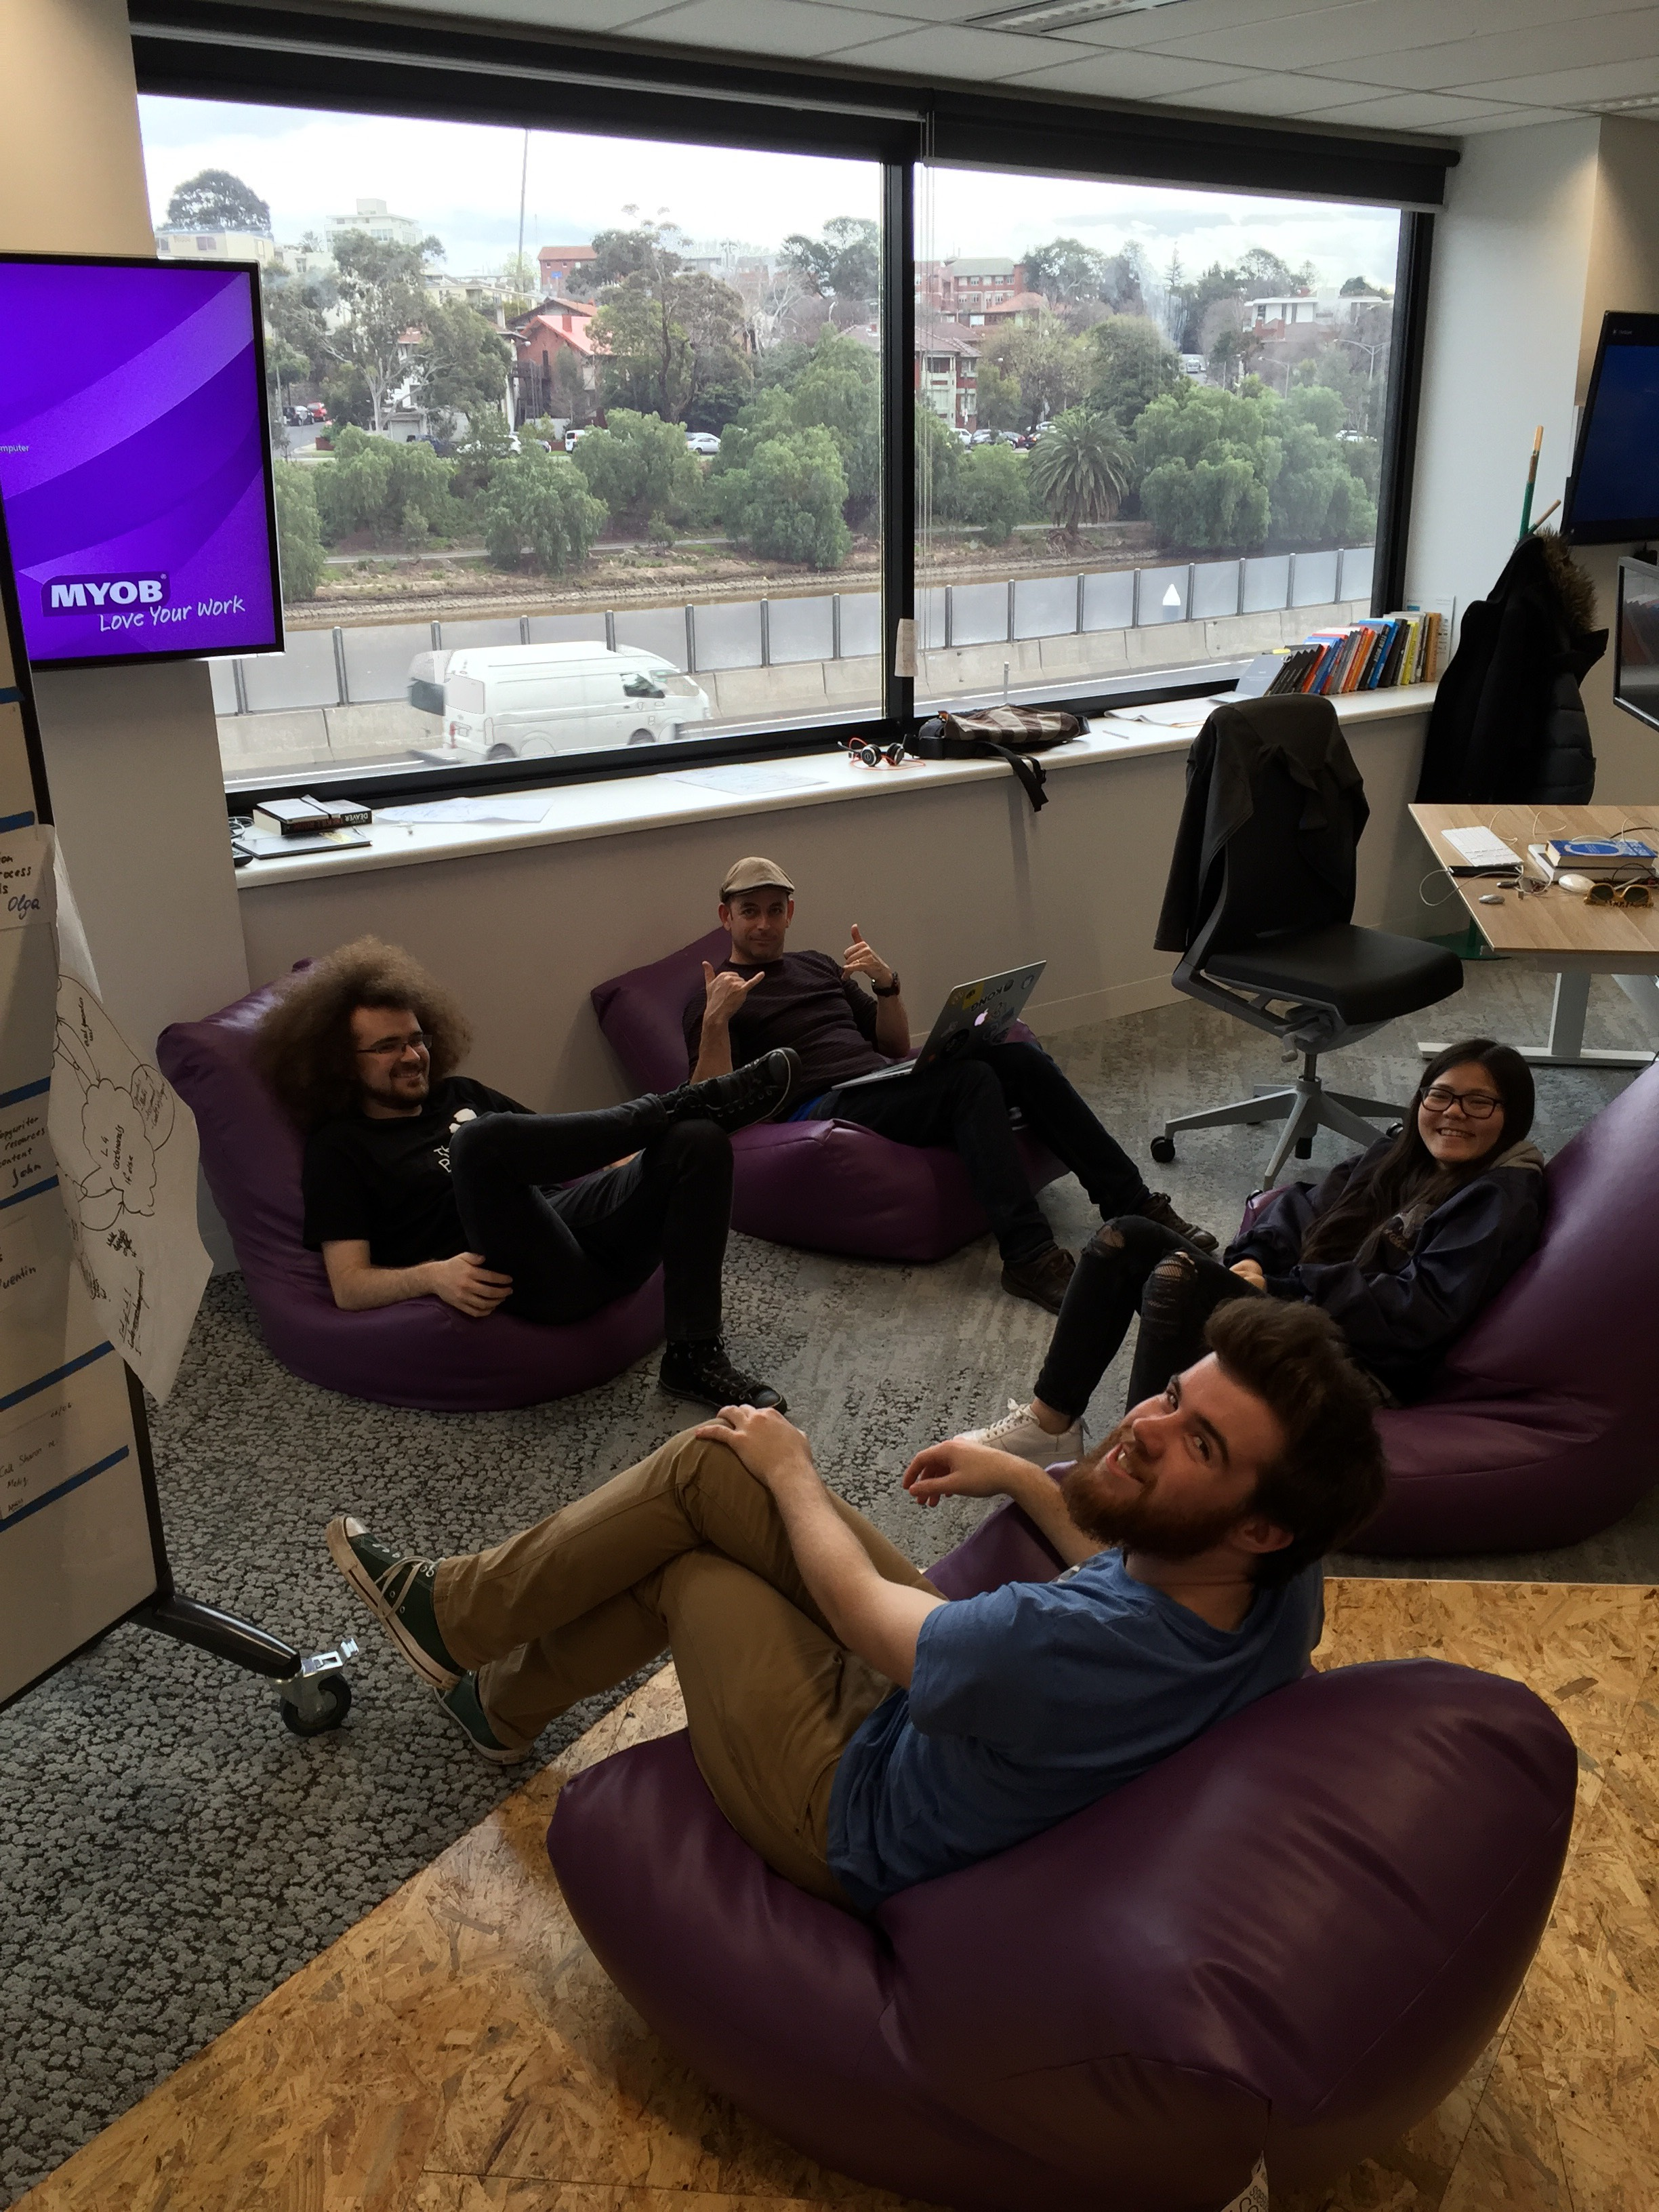
SRA
The atmosphere is ramping up, things are being put into boxes using equals, and there’s the sound of cyborg camera lenses scanning the room. SRA is in the house!
Thanks for everything, Simon! Your passion for teaching and tech is unrivalled.

Slide 10
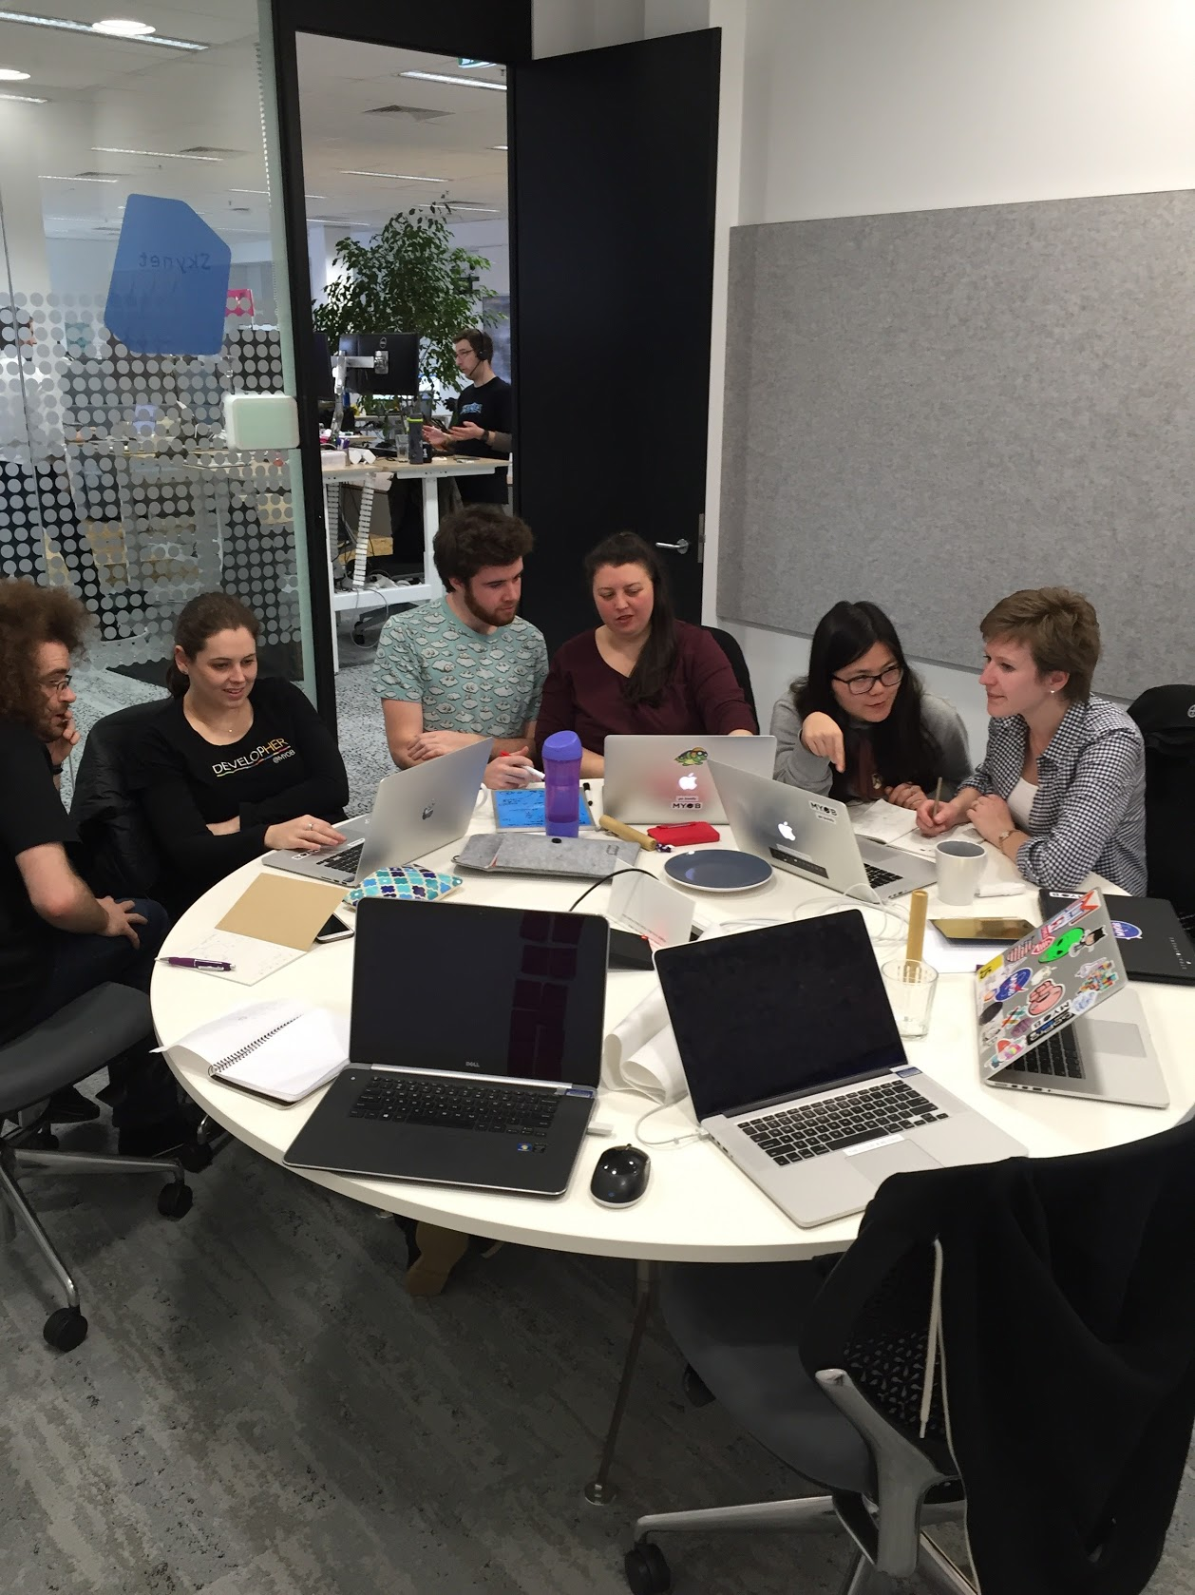
Classroom experience
Our classes were fun, engaging, challenging, frustrating, the list could go on and on!
Working together allowed us to form a really close bond with each other and our new colleagues, and by sharing our strengths and weaknesses we were able to succeed as a team
If anyone needs help with finding a MYOB carpark slack us ☺

Slide 11
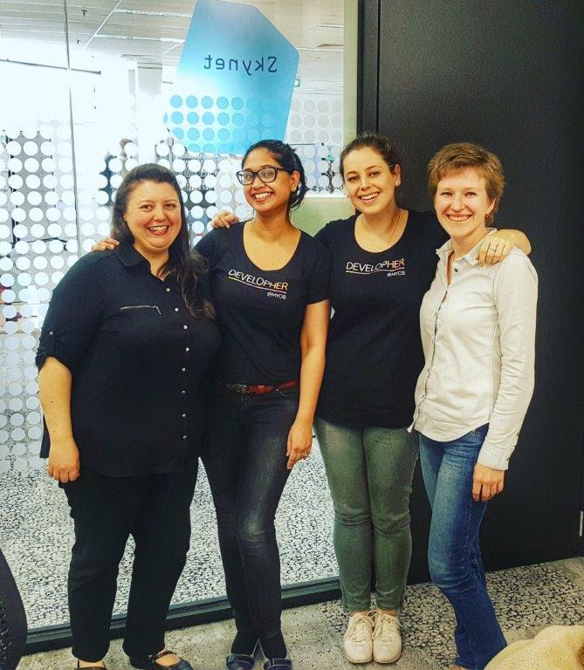
Our Buddies and mentors
A BIG shoutout is deserved by our buddies and mentors!
Angela, Jeannie, Pooja, Prash, Sally and Candice have all been amazing in offering their advice and support throughout our journeys.
Our team buddies Matt from Sora, James from Tranquility and Tim from Genesis have continued to support us as we develop and grow in our own MYOB teams, and apply our classroom skills to real life situations.

Slide 12
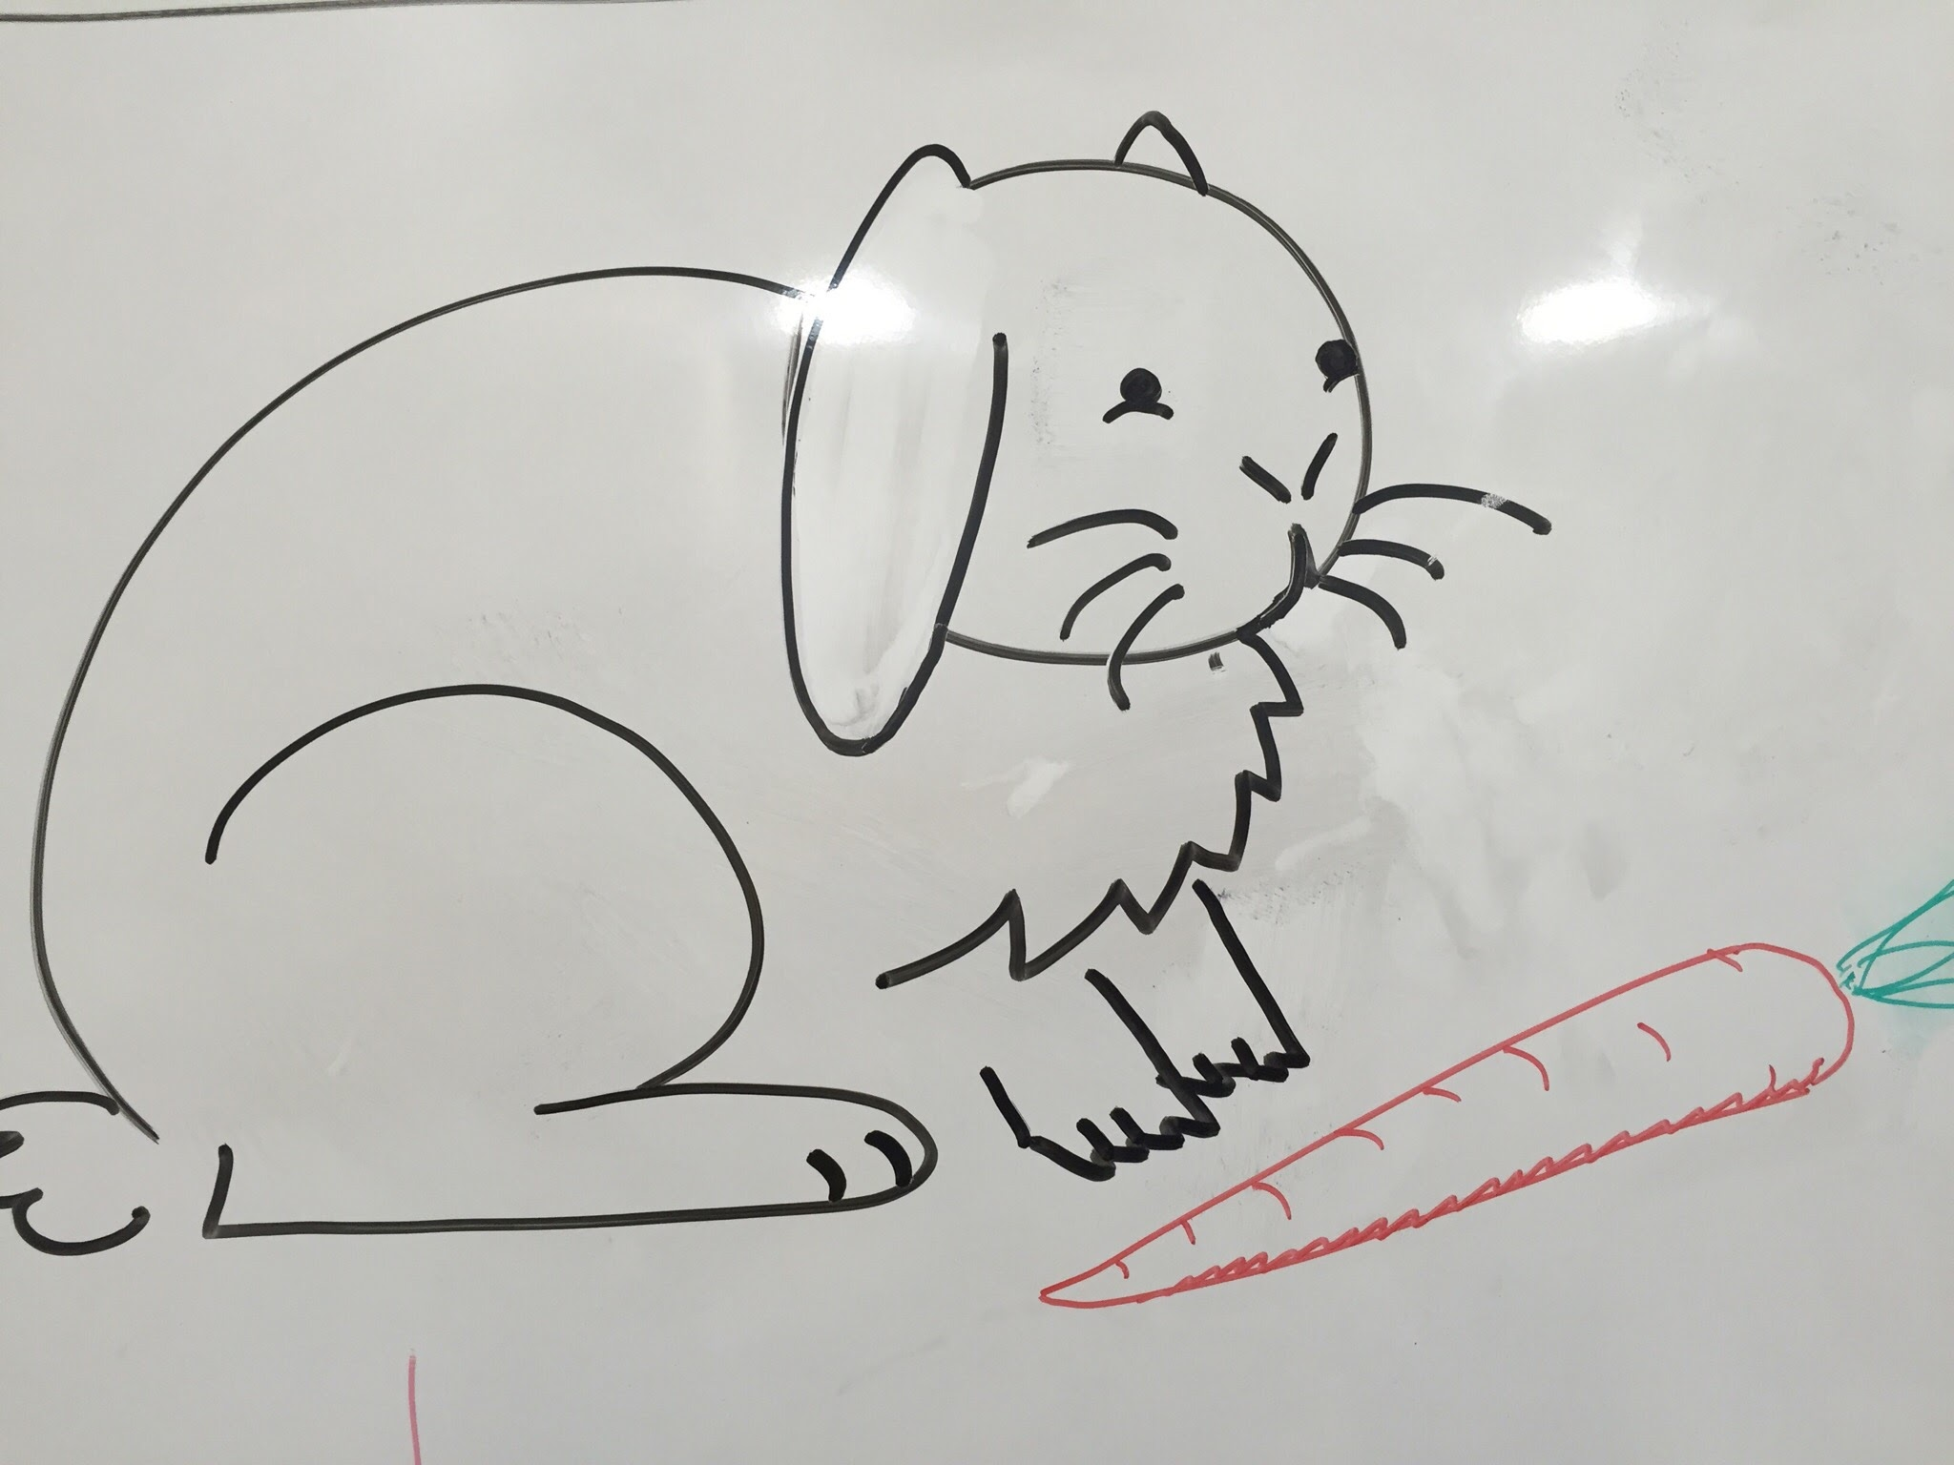
Lovely rabbit
The whiteboards at MYOB are notorious for being regularly cleaned, and are always photographed in case of such an event where critical plans are erased forever
Andrew’s lovely rabbit is a tale of determination and triumph, as he was able to live on the whiteboard for the entire 7 weeks of tech school!
R.I.P lovely rabbit – Your memory will live on forever in our hearts

Slide 13
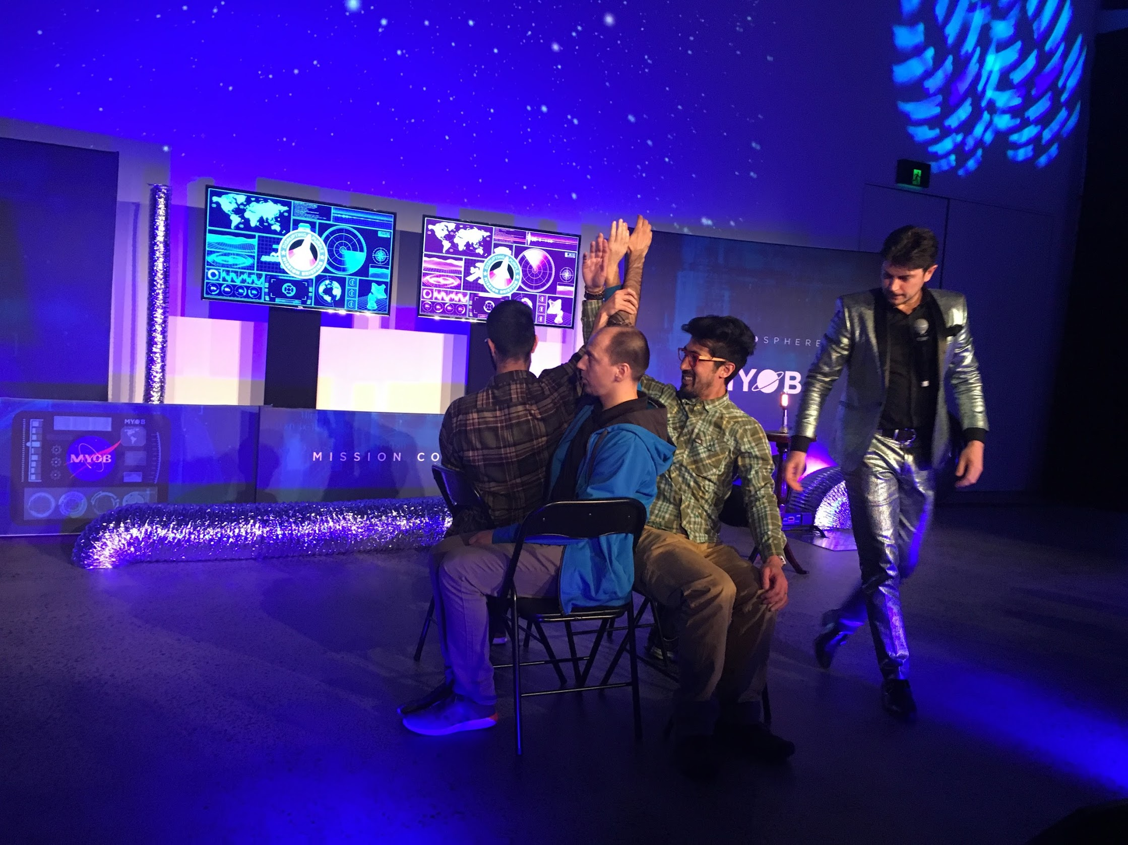
Disrupting Purple
Our first official company event – rocket ships, dancing storm troopers and awesome sweet treats, plus watching these guys do incredible feats of strength! Blown away by the passion and culture of MYOB!

Slide 14
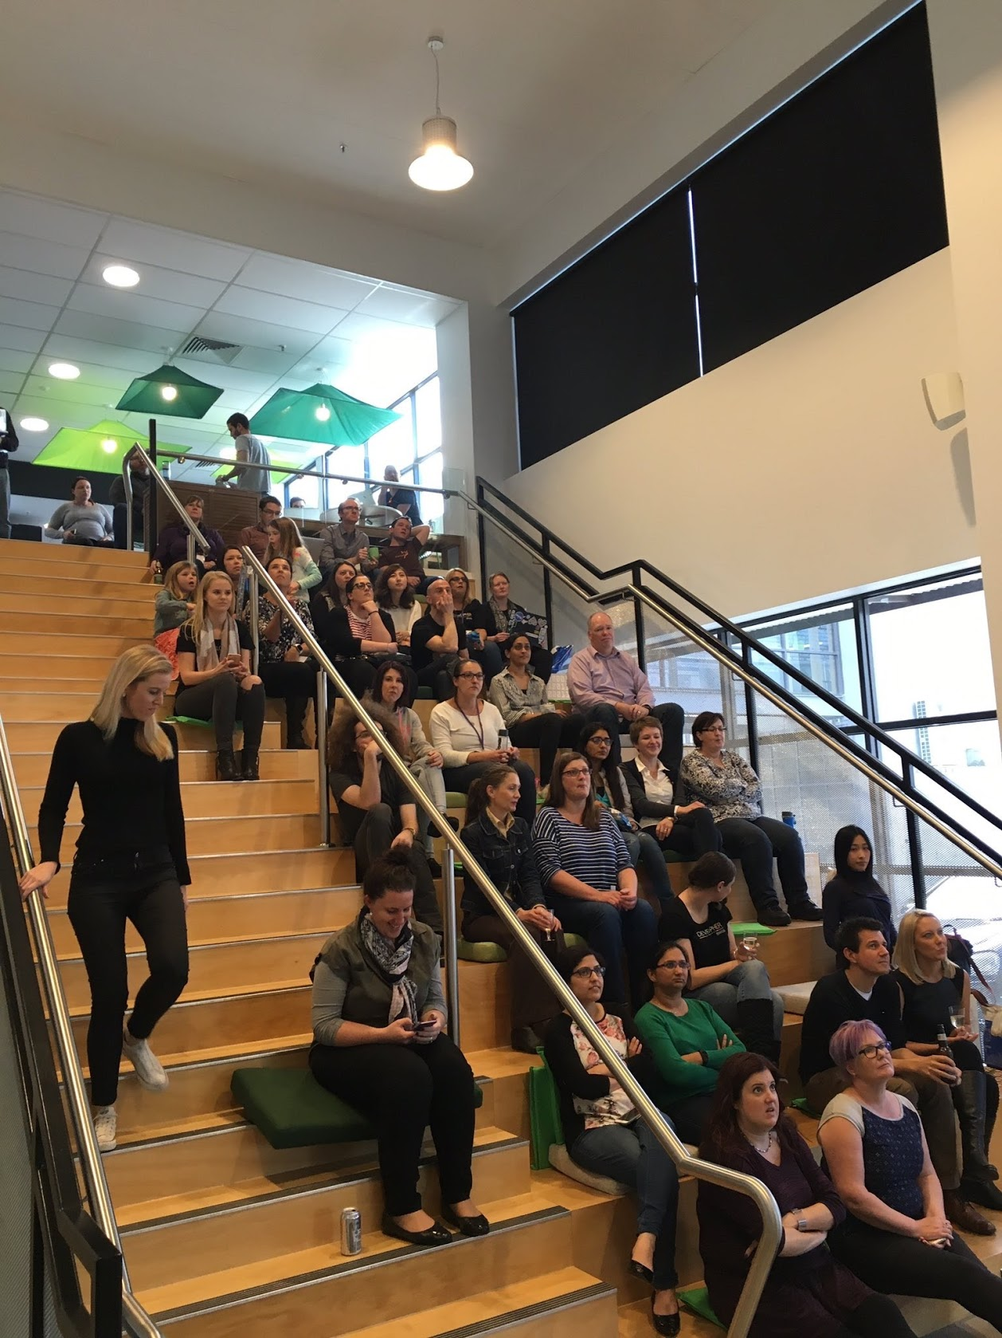
Code: Debugging The Gender Gap (A Documentary)
Our first opportunity to meet again with our other developHER friends who we had not seen since the interview day.
The movie really opened our eyes to the inequality that is currently present in the tech industry, and why programs like developHER are so important in trying to change current perceptions within the industry. It was also interesting to learn about the experiences women have had in different types of tech companies, and how important it is to focus on building and cultivating a positive work culture in addition to gender equality.
It was great to chat with the ladies who are still on their paths to becoming developHERs, and we hope that we can continue to inspire and support them on their journey, and hopefully welcome them into our family in the not too distant future ☺

Slide 15
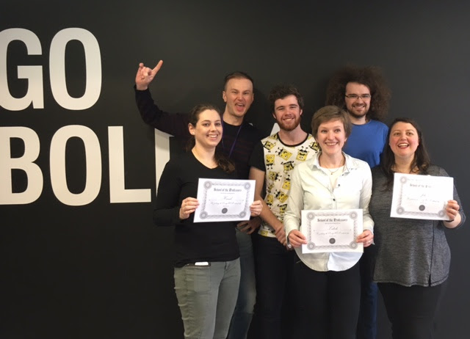
Tech School Grads
FINALLY WE MADE IT!
Professor Professorson and the associate professors pose with our shiny certificates and happy faces before we start the next chapter of our journey with our teams
Our certificates went straight to the fridge where they will stay for a very long time ☺

Slide 16
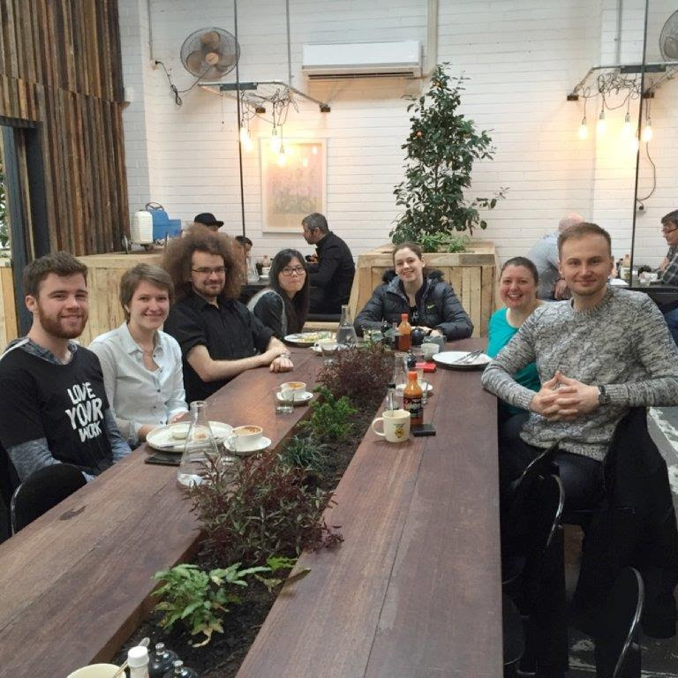
Tech School Wrap-up Party
Our final celebration with our professors before we join our teams – a bitter-sweet moment but we know they will do an amazing job with the new developHERs that start next year!

Slide 17
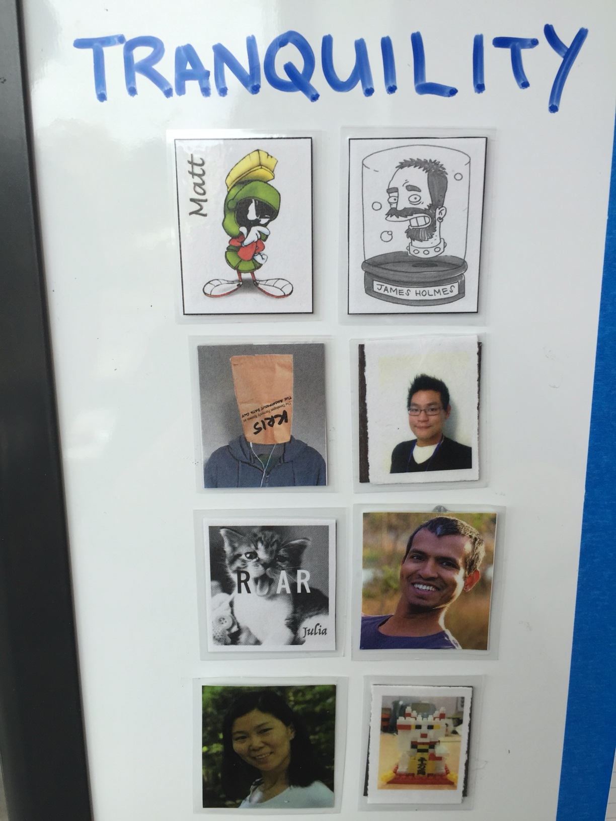
Team Tranquility
Do you hear the soothing sound of water? You have arrived at the Sea of Tranquility!
As our Slack channel describes, “ALL YOUR DATA ARE BELONG TO US!”
An amazing group of people who have been so generous with their time and their knowledge. From left to right, Matt, James, Kris, Suppa, Julia, Ravi, Lisa and Andy. Jay and SRA travelling incognito with no head shots ☺
Our team invoke the powers of Lochness Monsters, Krakens, and countless lambdas to ingest your data and spit out the answers to all your questions!
We enjoy yak shaving, telling jokes about promises and callbacks, and making water puns ☺

Slide 18
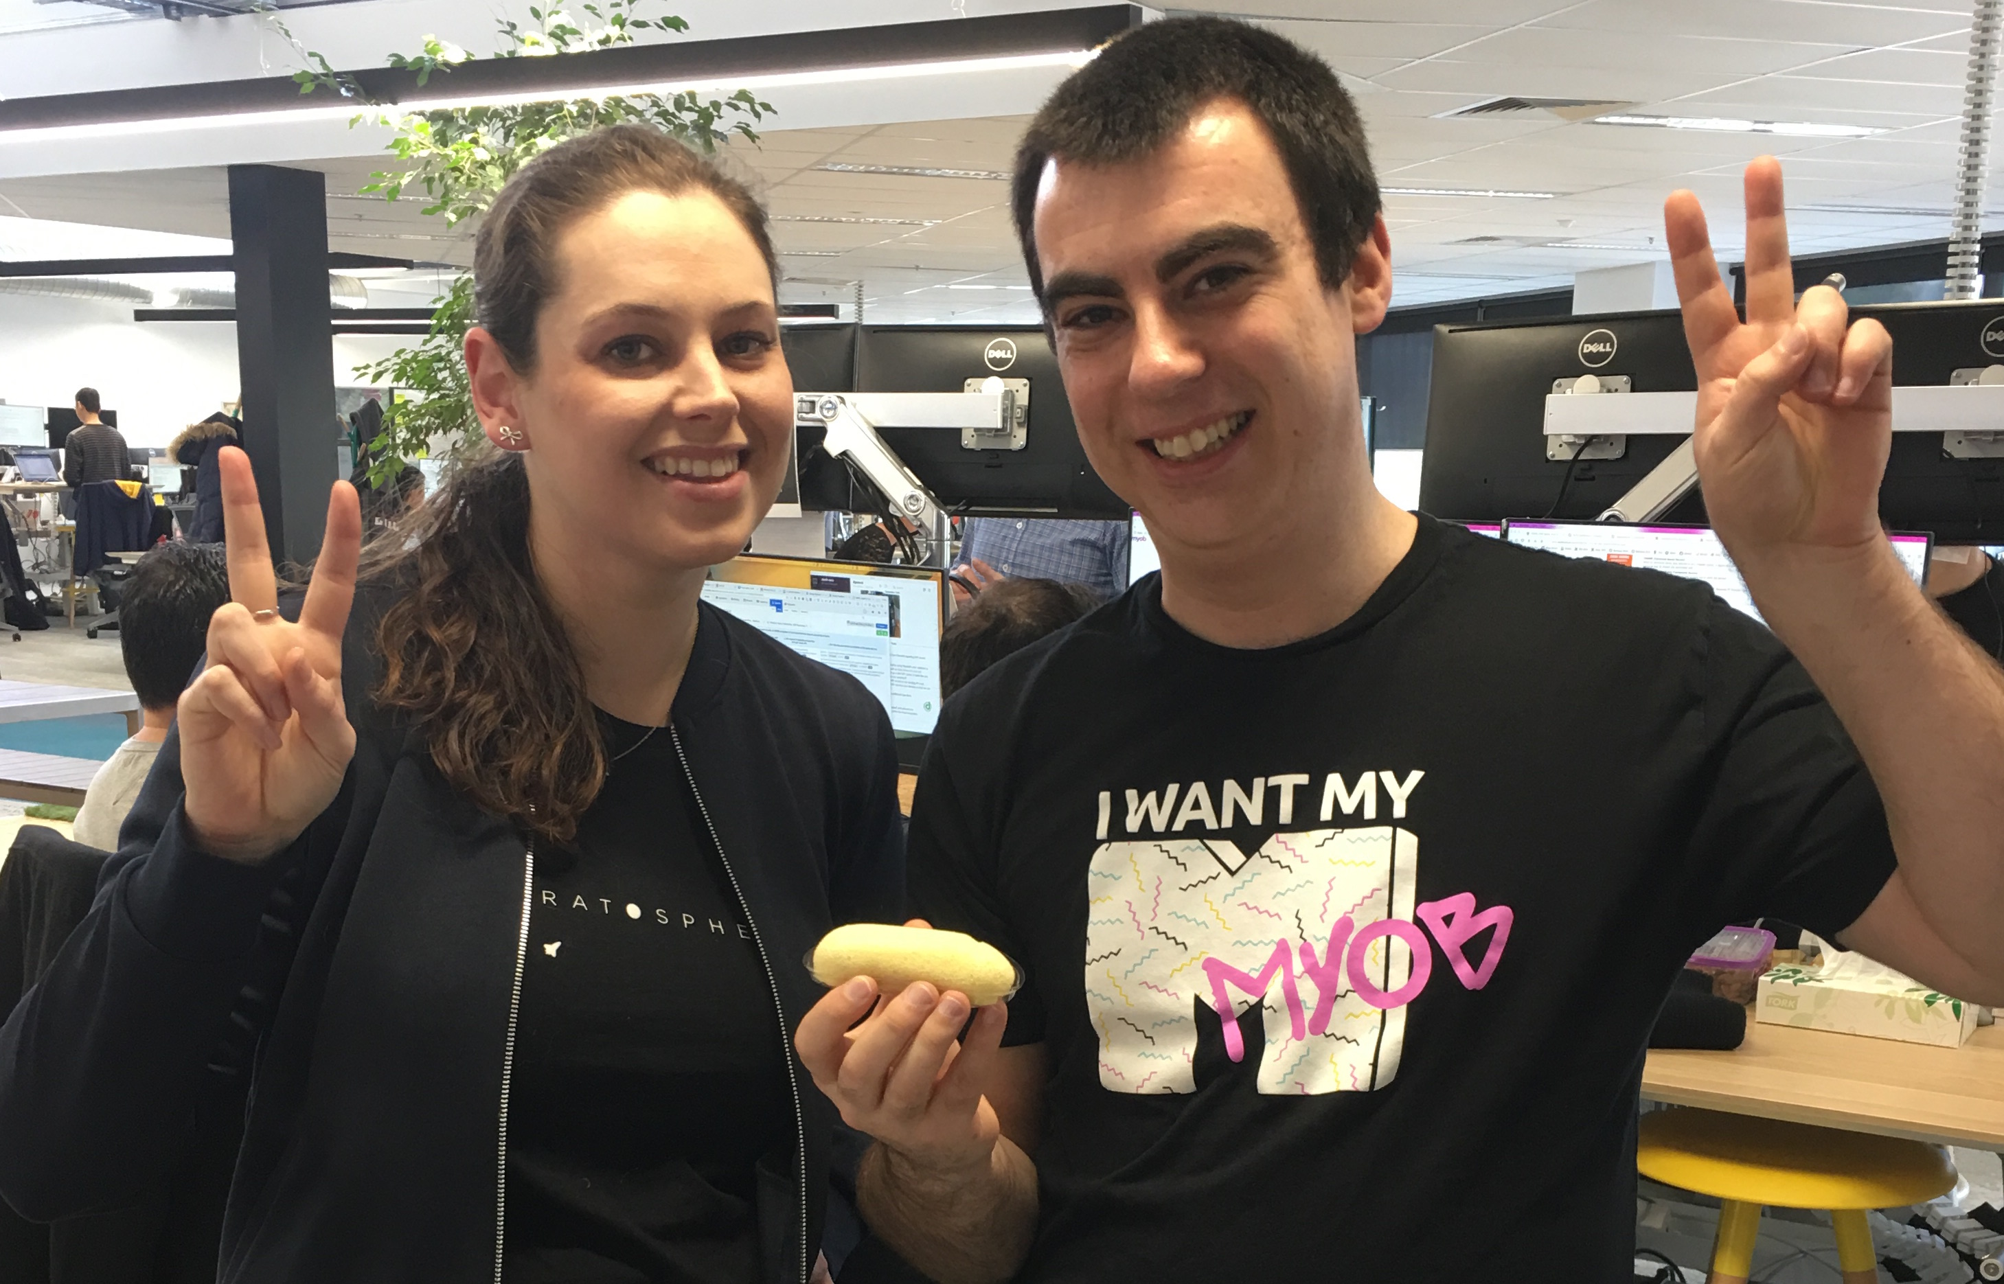
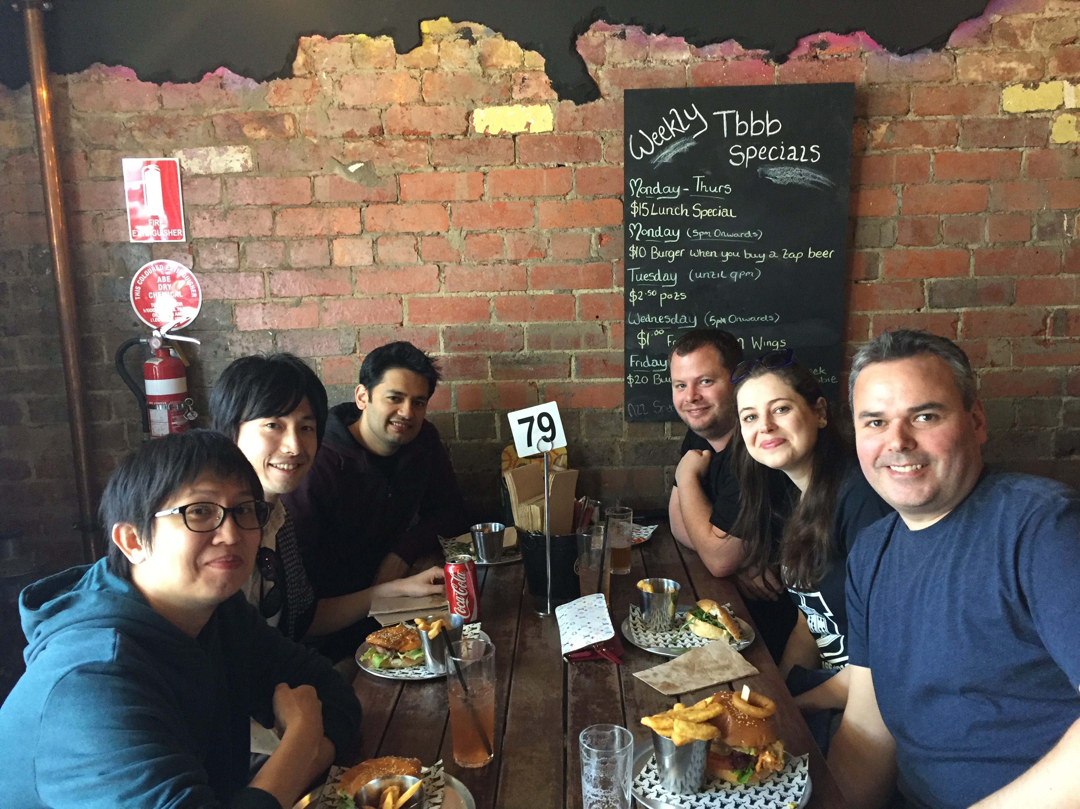
Team Sora
Top: Matt and Hannah
L-R: Sila, Ryuichi, Ash, Mark, Hannah, Tommo
Not present: Louis, Nalinda
Team Sora support the core business areas of email, invoices, payments and less core areas such as Atlas (sorry Thommo ☺).
They enjoy philosophical debates, ping pong, long walks to the coffee shop, and improving legacy code for generations to come!

Slide 19

Genesis team is responsible for delivering the Essentials Rebrand / Brand Integration stream of work.
Rebrand team (Genesis) to update old stack pages in essentials by:
Creating reusable react components
Updating styles to reflect new visual designs
Purpose:
To incrementally evolve Essentials into a simplified, modern and intuitive product experience, which will help us surpass the market share of our SME competitors.
Continual transformation of Essentials will improve product experience that will help our customer and partner businesses succeed.

Slide 20
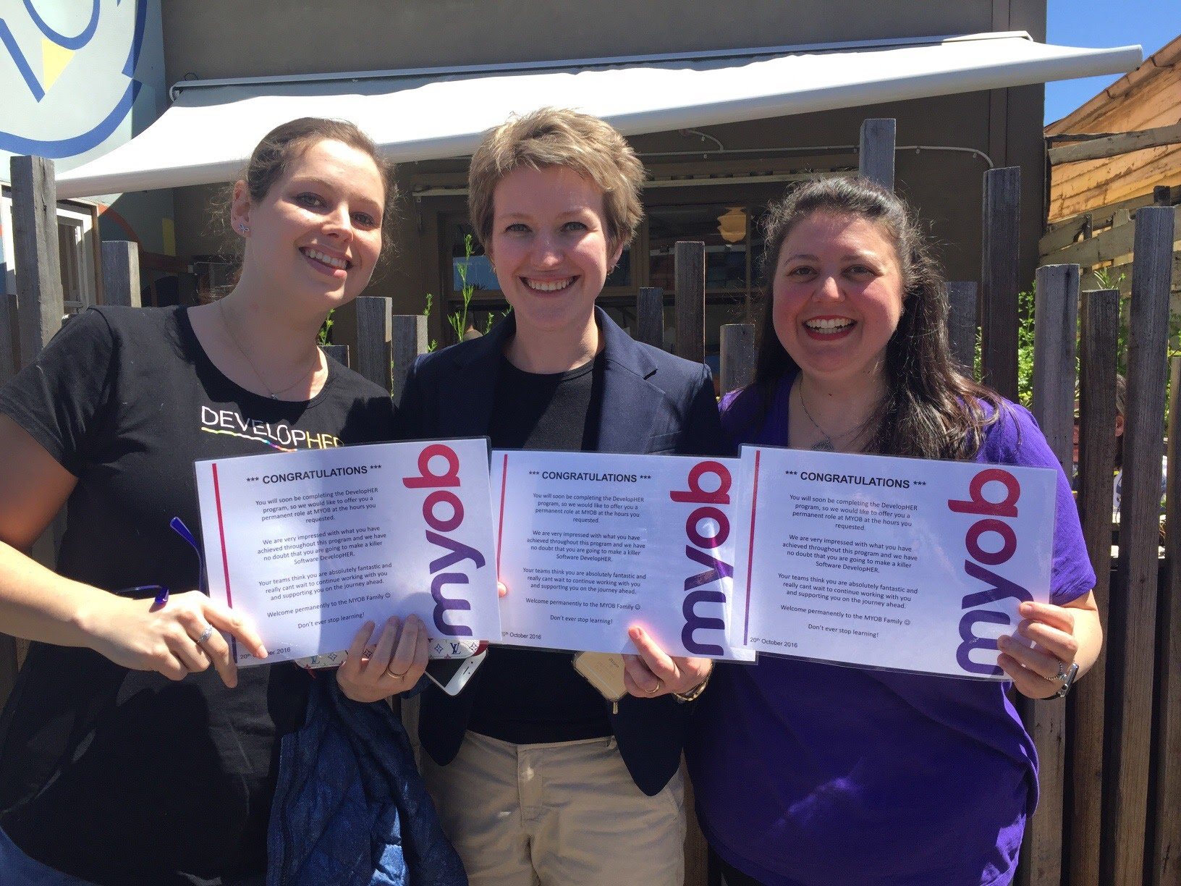
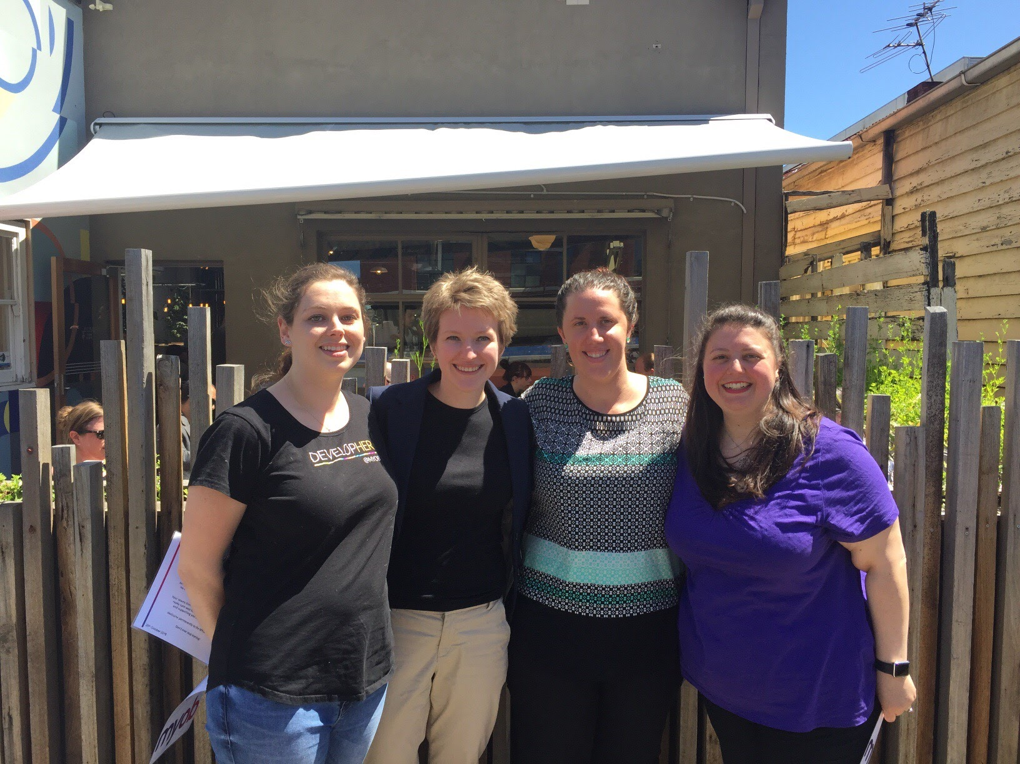
Graduate Developers
One of our most exciting days – Tanya, John and Katherine met us for lunch to present us with permanent role offers for 2017!!!
We are all still so thrilled, thankful and excited to be continuing our MYOB journey next year ☺
#GoBoldly

Slide 21
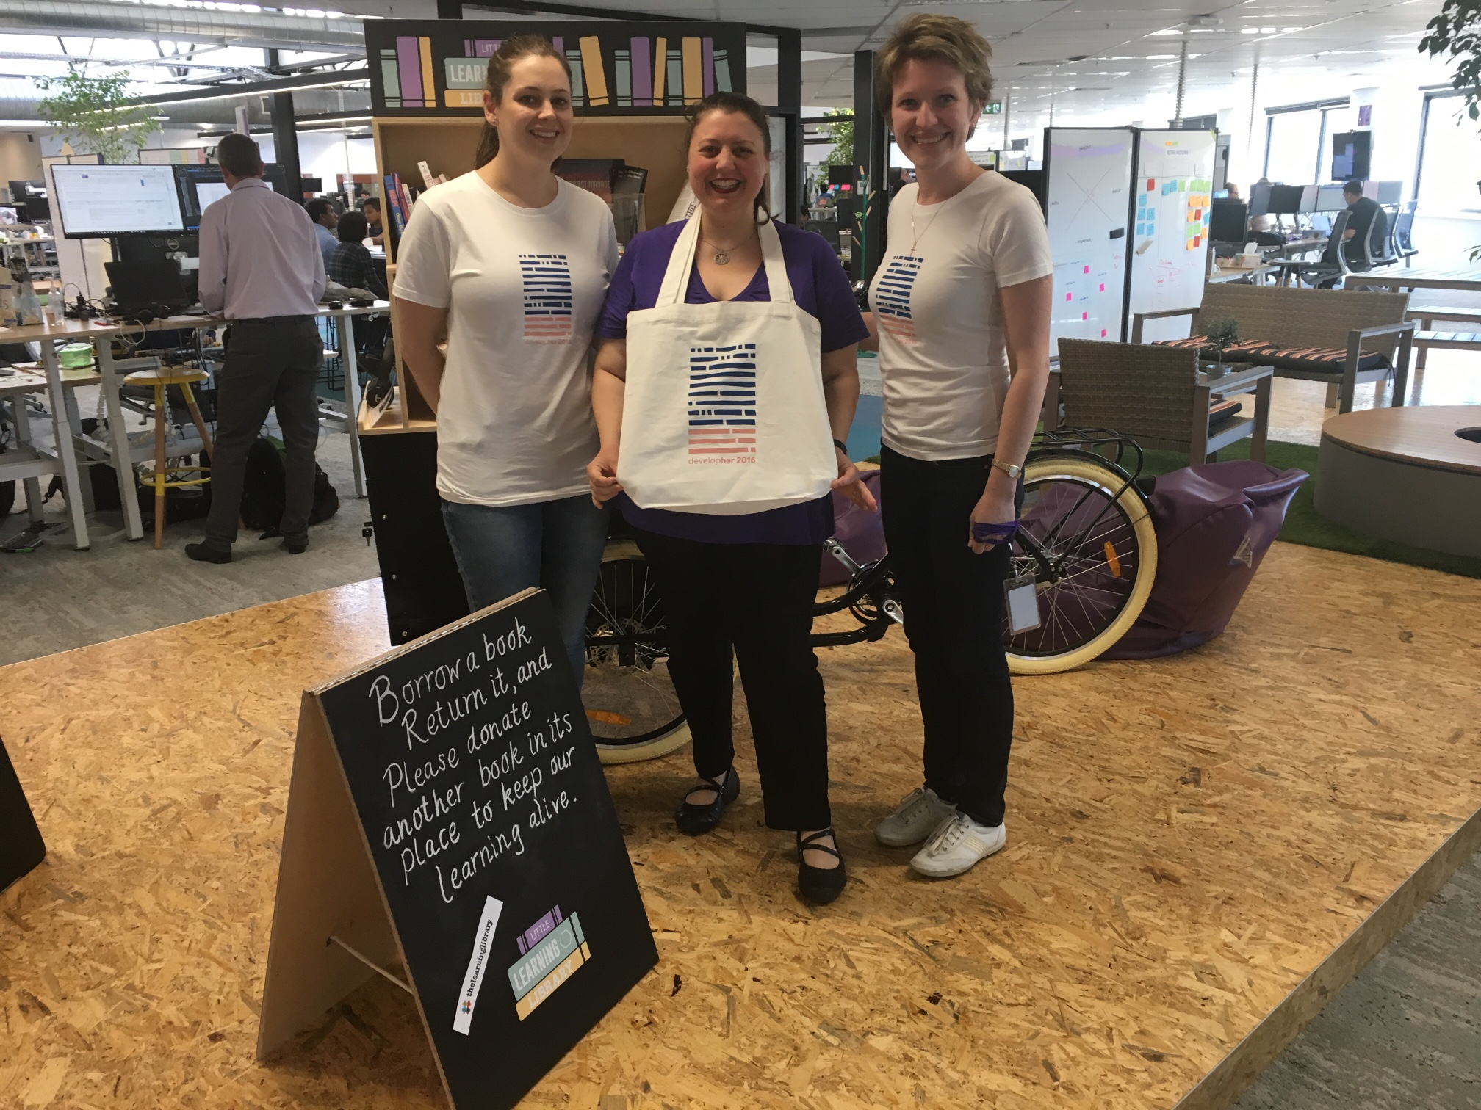
New DevelopHER T-shirts and totes
Thanks to Nick and Jeannie for their awesome job in creating new DevelopHER 2016 t-shirts and totes.
The story of their design encompasses the efforts of the adventurous and intelligent women who went before us. We are honoured to be the next link in a great legacy of women in tech

Slide 22
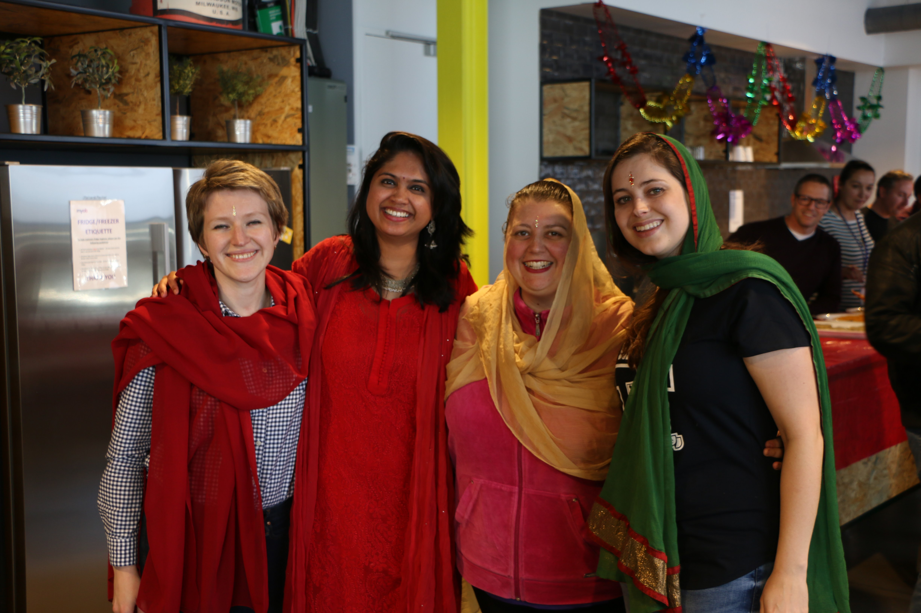
Diwali celebration
One of the things we have grown to love about MYOB are the people and celebrations – no matter the cause everyone is ready to celebrate with their colleagues and enjoy a new experience and adventure
Thank you to Pooja for assisting with our bindis and scarves to make us look beautiful for Diwali

Slide 23
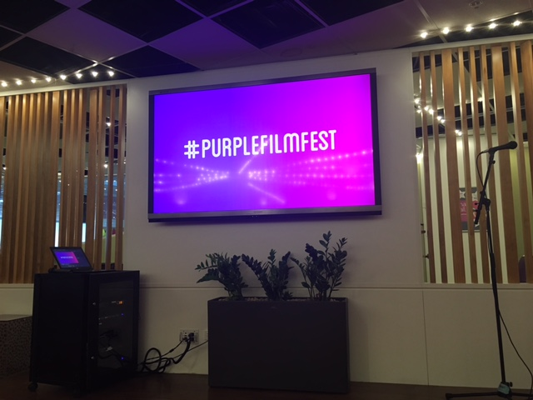
Purple Film Fest 2016
A gold class movie experience, complete with popcorn, alcohol and choc tops! Our first close up look and the creative and hilarious antics of our colleagues and a chance for us to see the Glen Waverley office in action

Slide 24

Making the Future whilst Making HERstory

Slide 25
Acknowledgements
John Sullivan
Tanya Windscheffel
Katherine Smyth
Andrew Bail
Angela Yu
Candice Nel
Clinton Eidelman
Dan Harper
Jeannie Kang
Jatin Bhasin
Jigger Fantonial
Jonathan Broome
Mandy Hicks
Mark Barber
Michael Shannon
Nick Bligh
Ognjen Babic
Pooja Elkunchwar
Prash Sagar
Sally Higgs
Simon Raik-Allen
Vidya Narasimhan
Vivian Chi
Nebula team
Sora team
Tranquility team
Genesis team

